Slide 1

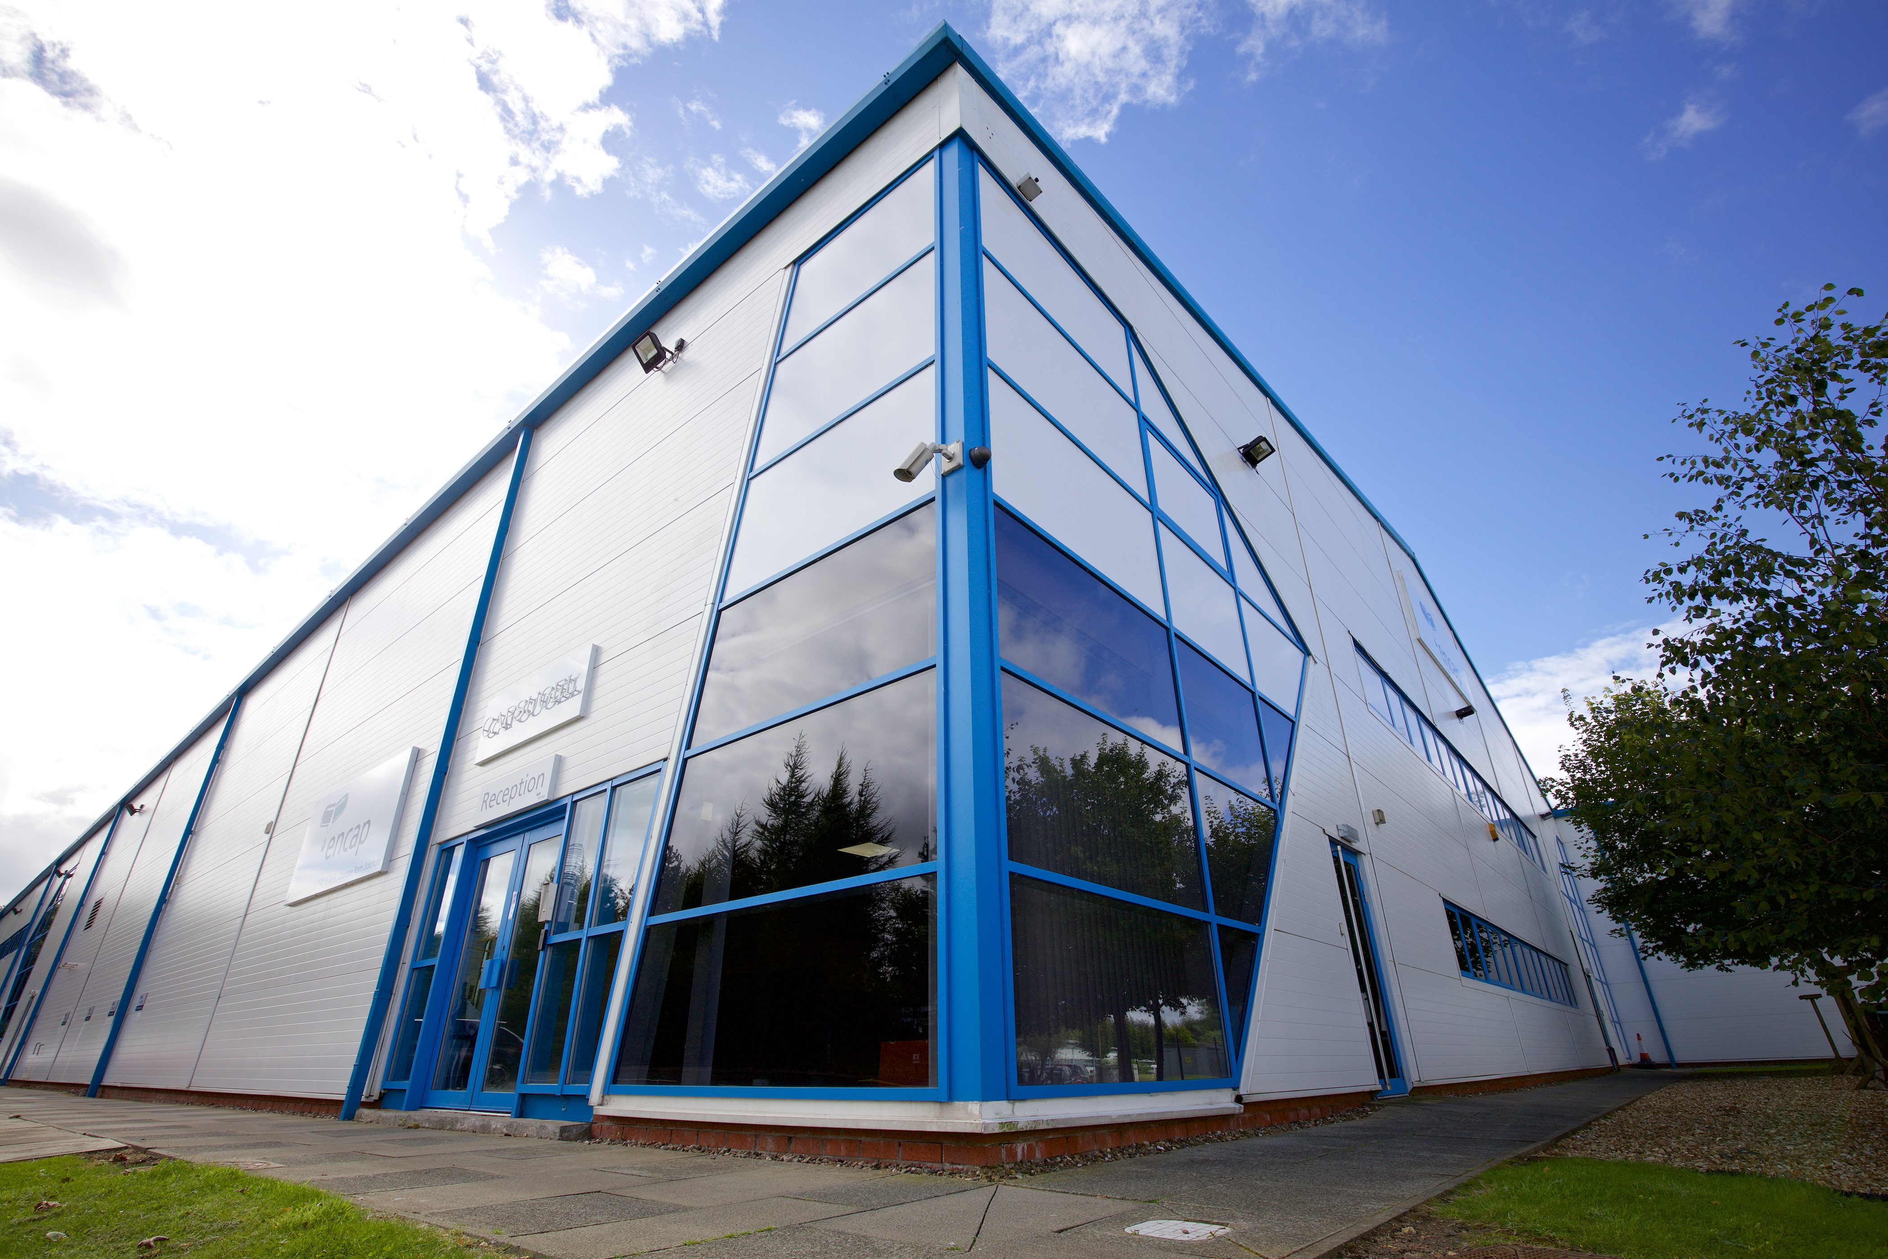



EDINBURGH
PRESENTATION
Say yes to what's next
Service
Passion
Speed

Slide 2



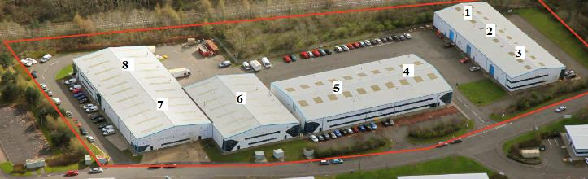
Edinburgh Highlights
Over 30 years of experience in liquid fill capsule development and commercial manufacture experience
Integrated on site product development capabilities
High potent API handling capabilities up to OEB 5 (<1µg/m³) in product development and manufacturing
Dedicated units for developing and manufacturing highly potent compounds
Commercial launch and supply chain expertise
80,000 ft² (7500m²) across Units 1 to 8, includes 25,000 ft² future expansion capacity
Approved by various health authorities for manufacturing investigational and commercial drug products for healthcare customers around the world

Slide 3
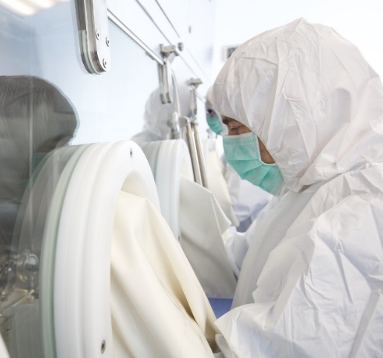
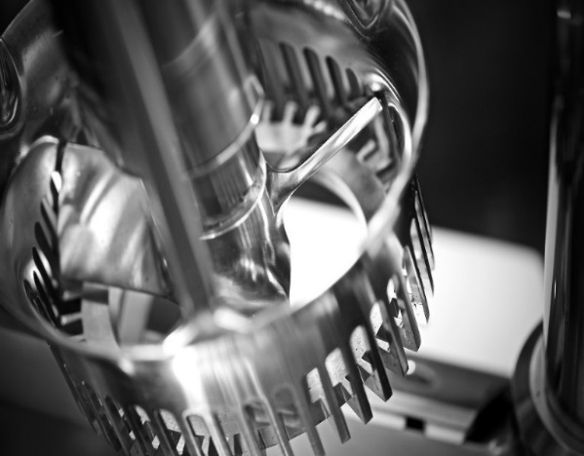
Product Development and Commercialisation
Product Development and GMP Manufacture – Worldwide Client Base
Formulated and advanced hundreds of compounds (NCEs and Generics)
Licensed Product Supply including US, EU and UK markets
NCEs and Generics
Multiple products in phase III or late registration phase
Experienced in tech transfers from other CDMOs for commercialisation
    Extensive Experience Across LFHC Applications
          Fast to Clinic
          Highly potent drugs (requiring containment)
          Bioavailability enhancement (SMEDDS/SEDDS)
          Controlled Drugs (Schedules 1 – 5)
Controlled release hot melt and matrix formulations
Solid and semi-solid formulations
Solution and suspension formulations
Injectable to oral conversions
Targeted release / colonic delivery / abuse deterrence

Slide 4
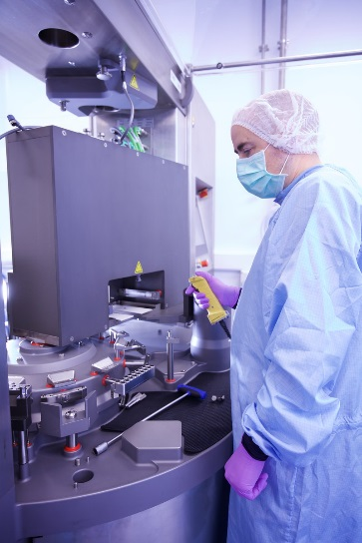
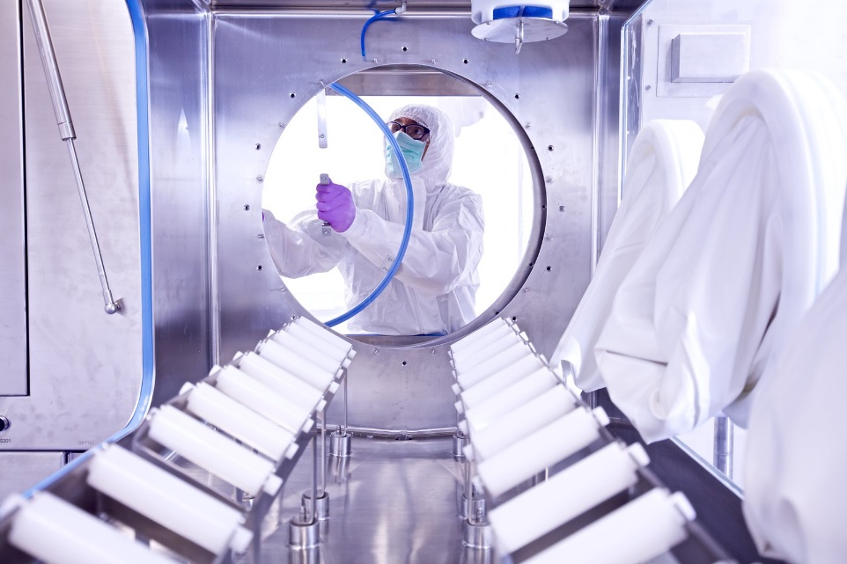
Clinical and Commercial Manufacturing
  Manufacturing Capability
  Three cleanrooms: two of which are high containment capable with single pass air handing systems
  Product development, process development and scale up all occurs on one campus
  Highly skilled production teams specialised in capsule liquid filling & banding and coating
  World Class FDA / MHRA GMP approved 80,000 square feet pharmaceutical manufacturing facility
  25,000sq.ft footprint for expansion, up to 40,000 square feet over two levels
  Technology Capability
  Powder containment
  Dispensing
  Milling
  Compounding
  Hard Capsule liquid filling
  Capsule banding and sealing
  Enteric or targeted capsule coating
  Finished capsule printing
  Capsule in capsule manufacturing
  Product packing

Slide 5
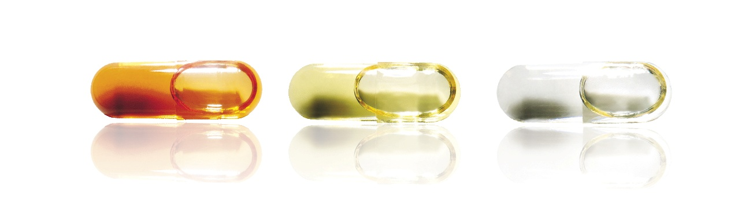
LFHC Technology Versatility
Minimal process steps: Much simpler to scale up
Rapid development: Can be conducted at all scales from pre-clinical to commercial
Versatile: Flexible technologies that can be tailored to numerous, unique delivery profiles
Filling
LFHC
Banding
Mixing
Excipient addition
Granulate
Tablet
NextPharma Edinburgh offer best-in-class technology and processing for LFHC product development, scale-up and manufacturing
Screen
Wet Mass
Compress
Lubricate
Dry Blend
Screen
Dry

Slide 6
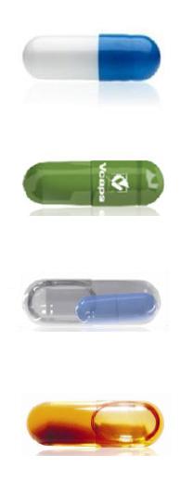
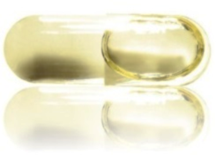
LFHC Technology Versatility
Highly Potent drug product manufacture
Abuse Deterrence
FIH/Clinical development
Ease of formulation development and scale up
Modified release and focused GI targeting
Liquid Filled Capsules
Milling
Low Dose and Content Uniformity
Bioavailability Enhancement

Slide 7

Pharmaceutical Product Development
Analytical Development Services
  Development and/or transfer of analytical methods (API, Drug Product, excipients)
  Validation/verification of analytical methods
  Analysis of prototypes, clinical and regulatory batches, validation batches
  Final release testing
  Product stability testing

Slide 8

Site Manufacturing Capabilities

Slide 9
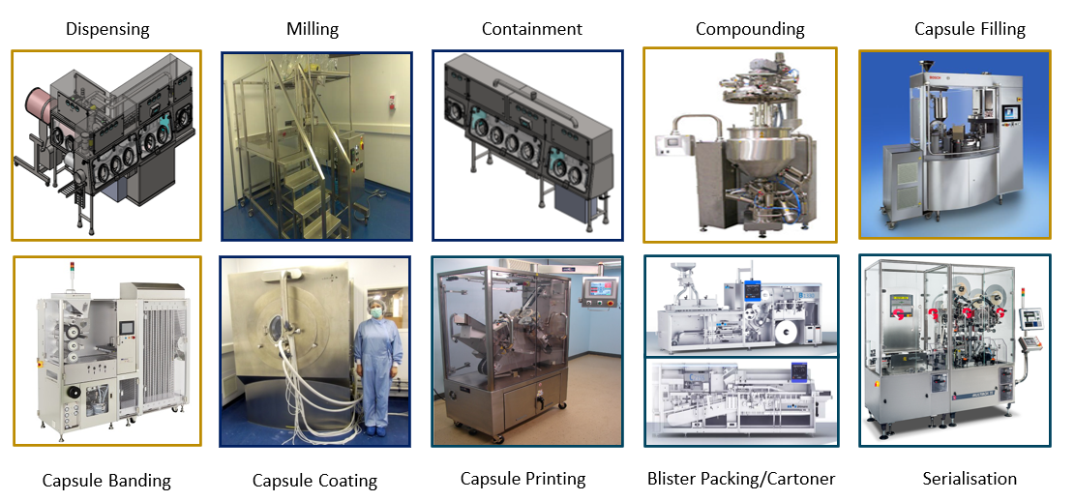
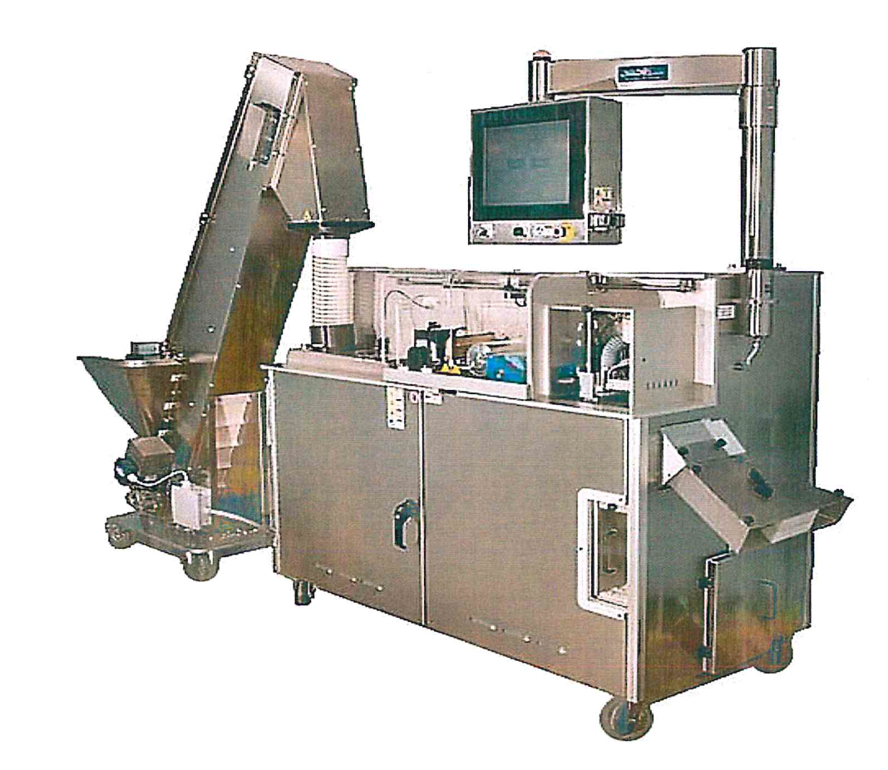
Large Scale / Commercial Manufacture Equipment Train

Slide 10
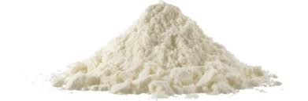
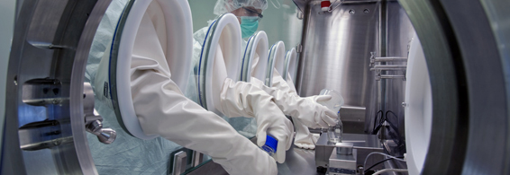
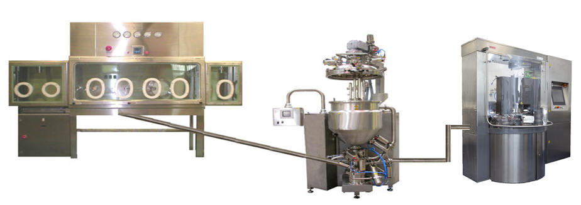
HPAPI Product Manufacture with LFHC Technology
Pharmaceutical product manufacturing processes routinely powder based
Each powder containing process step for high potency needs to have its own containment. For scale up, a new containment approach for the new scale can be required
As the process steps can be different, each product often may require a unique solution
Each unique solution requires to be assessed individually for the potential of operator exposure
Enclosed isolator based technology is expensive
HPAPI and LFHC Technology
Only the dispensing step requires containment
For all subsequent steps the API is wet by the liquid formulation and no dust is generated
The HPAPI, is compounded in an isolator and transferred under vacuum directly into a mixing vessel
Once wet, by liquid excipients, airborne contamination is removed and the process is intrinsically safer
Ongoing manufacture can be contained, with reduced engineering and PPE controls

Slide 11
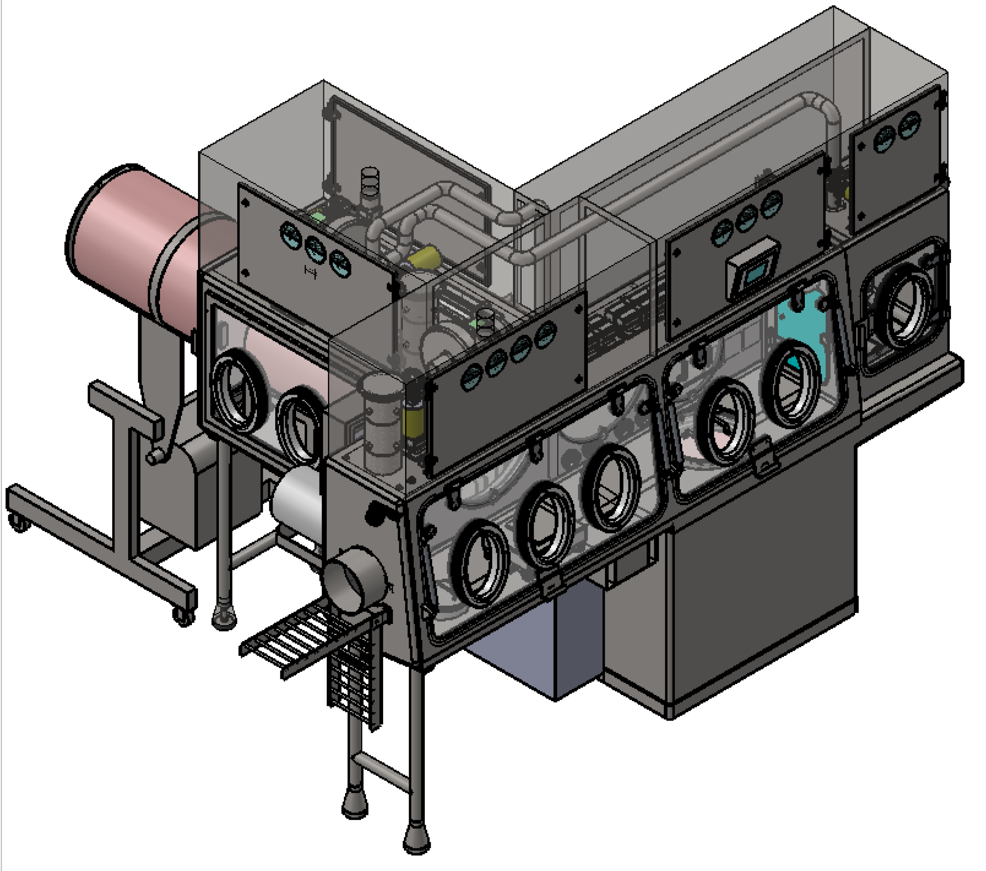
High Containment Dispensing Isolator
Pre-dispensing of API can allow the process to remain consistent and safe at compounding stages
Currently qualified to 0.05µg/m³
Custom built isolators specifically designed for flexibility of containers provides a means to manage differing supplies of HPAPI
Scale-up considerations
Increasing API container size
Different containers from alternative manufacturers
Dispensing and Sampling
Compounding hygienically
Control
Custom Built Pre-Dispensing Isolator with multiple flexible docking systems
Separate configuration for sampling
Simple standardised compound isolator post pre-dispensing
Notes:
No matter what the manufacturing route, powder handling will be required at some point in the process
Often due to limitations at specific manufacturing sites, raw materials or API does not arrive in ideal containers, or pack sizes, and may not be hygienically clean to allow opening safely
To aid handling of large volume HPAPI, it is often easiest to sub-dispense into hygienic pack sizes of mangable size
Specialist isolators can be designed and built for an individual process or with multiple process capability
Different ports, container capability and staged entry and exits all decrease operator and cross contamination risks
Industrial hygiene is used to demonstrate safety exposure controls and is

Slide 12
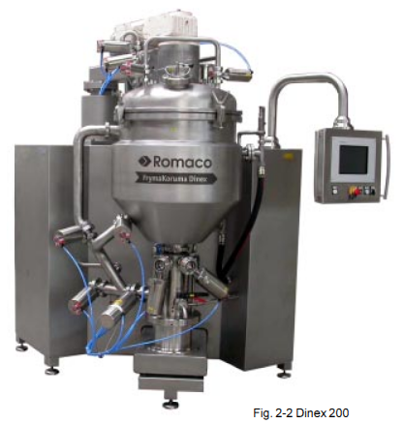
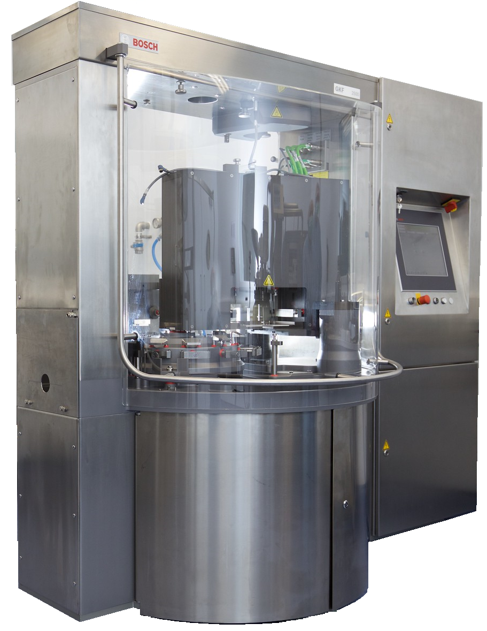
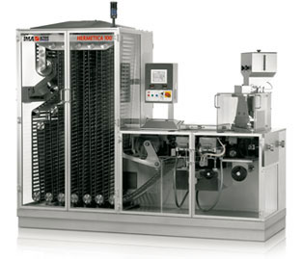
High Containment Suites
  High Containment Suites in line with Global Development & Commercialisation Need
  High Potent & Cytotoxic Drug Laboratory, Development, Manufacture, Packaging, Warehouse Capability
  Additional LFHC Capability - Investigational Medicinal Products
  Bench Scale Formulation Development
  GMP Clinical Trial & Commercial Batch Manufacture
  Pilot Scale Process Development
  Full Commercial Scale Manufacture
  Clinical and Commercial Scale Blister Packaging
12

Slide 13
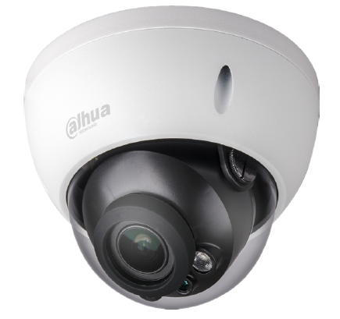
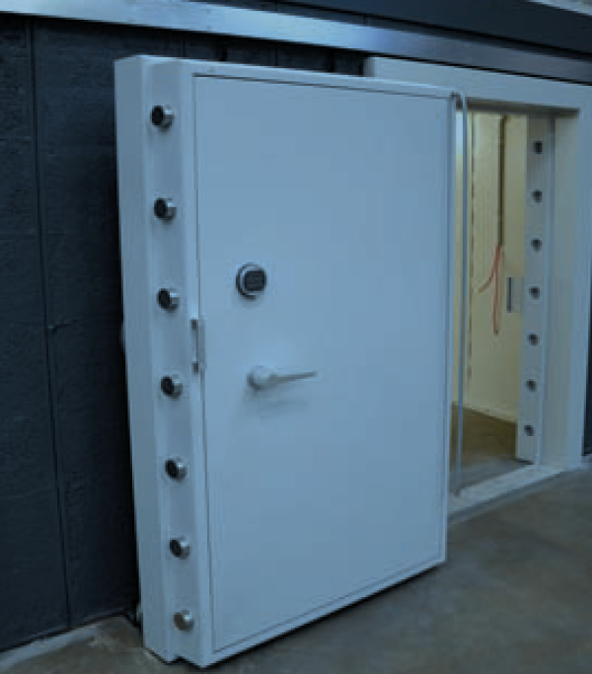
Controlled Drugs
The site has a controlled drugs license for Schedules 1- 5 (UK)
Expertise in working with controlled drugs for a range of products
Abuse Deterrence - for Opioids and other drugs of abuse
Lipids - for greasy molecules requiring bioavailability enhancement
Controlled release – for kinetic release profiles
Targeted – for local action, such as in the colon
The Edinburgh site has walk-in scale, grade 6 strong room for storage of controlled drug substances and products
The Edinburgh site has CCTV installed for the purpose of monitor storage and activities of highly controlled substance. CCTV is also monitored outside working hours

Slide 14
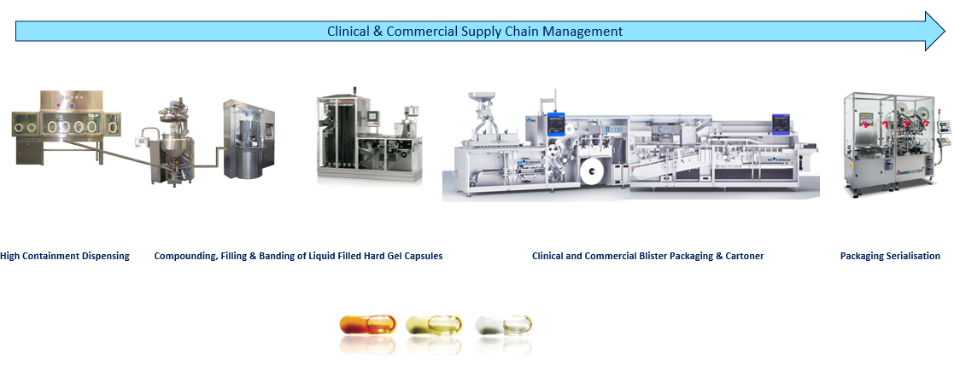
End to End Solution for Manufacture
Manufacturing, Packaging & Supply Chain

Slide 15
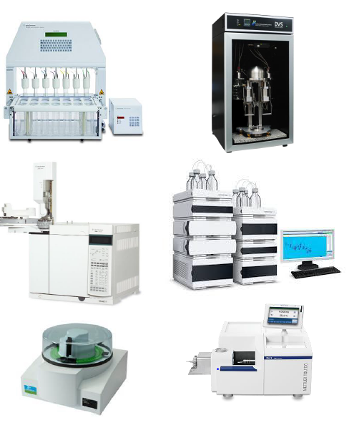
Material Analysis and Testing
Testing facilities for Highly Potent API and Products
HPLC with DAD, VWD, RI, Fluorescence and ELS detection
UHPLC with MS, DAD detection
GC including static and dynamic headspace samplers
Dissolution Apparatus I, II & III, including offline samplers
Modulated Differential Scanning Calorimeter
Malvern Mastersizer Laser Diffraction Particle Size Analyser
Viscometers with Cone and Plate
FTIR including ATR and Drifts
Dynamic Vapour Sorption
Thermogravimetric analysis
Karl Fisher

Slide 16
Edinburgh Overview
NextPharma
Edinburgh
3 decades expertise
Problem solving
Technologies
Specialised Facilities and Equipment
Quality:
FDA, MHRA approved
People
Integrated capabilities

Slide 17
Edinburgh Site
Technologies

Slide 18
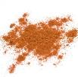
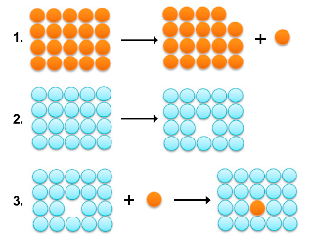
Bioavailability Enhancement Technology Selection Rationale
Characterised technology selection
Experienced formulators to scientifically ensure lipids is the appropriate technology
Use of physiochemical properties to aid in formulation development route selection
Ongoing properties mapping of developed products to provide highest future possible success rates
Extensive in-vitro tools to aid in pre-clinical development
Solid-state
“Brick dust”
Strong crystalline lattice
Bypass the crystalline state
Solvation
“Greaseball”
Low affinity for water
Change the solvent nature
Notes:
Need to add the ref to the paper

Slide 19
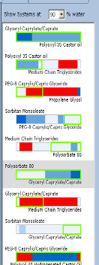
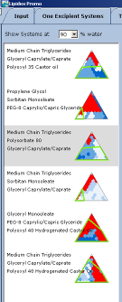
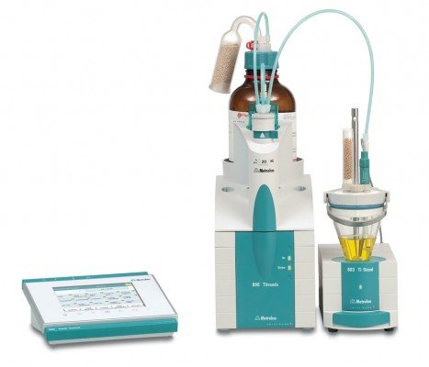
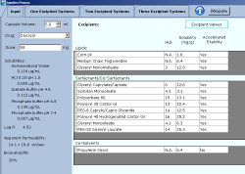
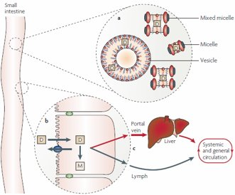
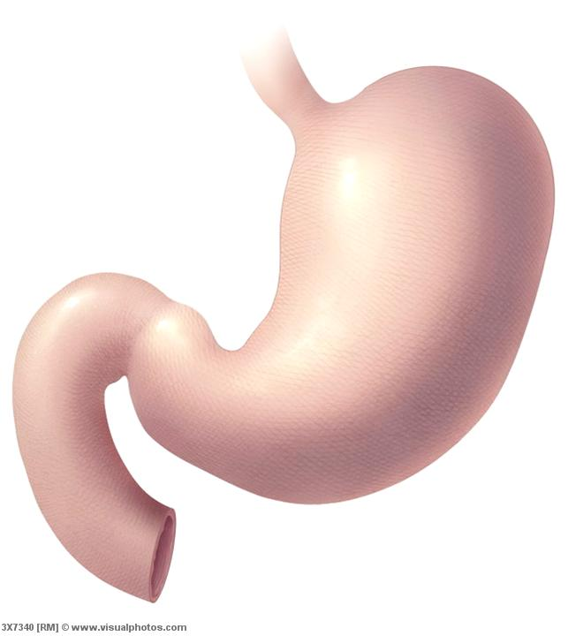
Bioavailability Enhancement with Lipid Formulations
Scientifically rationalised formulation design
Formulation development techniques from experienced developers and aided by software
Exclusive and extensive in-house lipids formulation database
In-vitro screening tools incorporating digestive modelling for formulation optimisation and in-vivo performance prediction
Pre-formulation solubility findings
ABSORPTION
Oil and surfactants emulsify under gastric conditions and agitation
Consistent gastric emptying similar to aqueous solutions, for rapid onset
Increasing solubilization and drug disposition in the intestinal lumen
Impacting the absorption pathway of drug transport to the systemic circulation
Interacting with natural enterocyte-based transport and metabolic processes
Emulsification
SOLUBILIZATION
Christopher J. H. Porter et al. , Nature Reviews 2007
Notes:
Figure 2 | Lipid digestion and drug solubilization in the small intestine. Following ingestion, the digestion of
exogenous dietary triglyceride (TG) and formulation TG is initiated in the stomach by gastric lipase. The stomach
further contributes to lipid processing by mechanical mixing (propulsion, grinding and retropulsion), which when
combined with the presence of the amphiphilic products of initial lipid digestion (diglyceride and fatty acid) facilitates
formation of a crude emulsion (lipid digestion by lingual lipase in the mouth might precede gastric digestion; however,
pharmaceutical formulations are typically encapsulated so that their contents are released in the stomach after
ingestion). In the small intestine, pancreatic lipase together with its cofactor co-lipase203 completes the breakdown of
TG to diglyceride, monoglyceride and fatty acid. Pancreatic lipase acts primarily at the sn-1 and sn-3 positions of TG to
produce 2-monoglyceride and free fatty acid203,204. The chemical digestion of formulation- or biliary-derived
phospholipid (PL) also occurs in the small intestine in which pancreatic phospholipase A2 hydrolyses a single fatty-acid
molecule from the sn-2 position of PL to yield lysophosphatidylcholine and fatty acid205,206. The presence of exogenous
lipids in the small intestine also stimulates secretion of endogenous biliary lipids, including bile salt (BS), PL and
cholesterol from the gall bladder. In the presence of raised BS concentrations, the products of lipid digestion
(monoglyceride, fatty acid and lysophospholipid) are subsequently incorporated into a series of colloidal structures,
including multilamellar and unilamellar vesicles, mixed micelles and micelles. Together these species significantly
expand the solubilization capacity of the small intestine for lipid digestion products and drugs (D). The oil droplet in the
intestine is stylistically represented in different colours to indicate undigested TG in the core (orange) and digested
products such as fatty acid (blue) and monoglyceride (green) on the surface of the droplet.

Slide 20
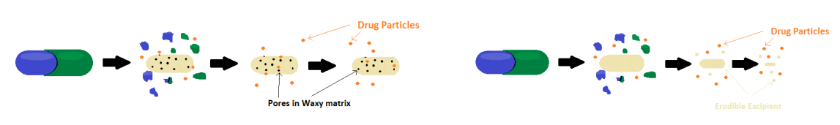
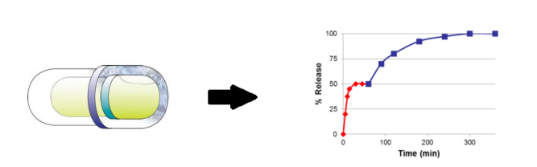
Modified Release with LFHC Technology
LFHC technology can incorporate controlled release polymers, functional coatings, or capsule in capsule formulations to tailor dissolution profiles.
I. Excipient incorporation in formulation for diffusion and / or erosion mechanisms. Alcohol induced accidental, or intentional, dose dumping can be minimised by use of an insoluble waxy matrix or gelling system
II. Functional coatings using either pH triggered release or erosion release mechanism can be readily applied to LFHC formulations using standard coating equipment.
III. More complex release systems can be created by combining targeted products and modified release products. Capsule-in-capsule technology provides anapproach to achieve dual release profiles or fixed dose combinations.

Slide 21
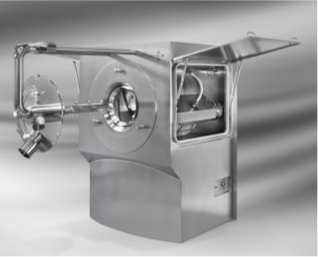
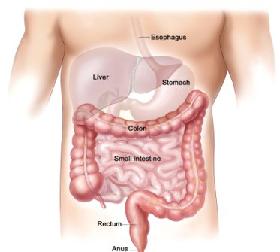
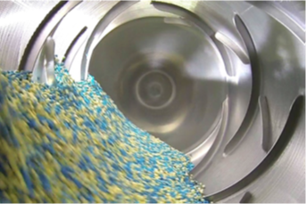
Targeted Release with LFHC Technology
Benefits
  Liquid fill potentially advantageous for colon delivery as there is low water and entrapped air
  Sustained fill formulation is ideal for topical application throughout the colon
Targeted delivery
  Intestinal targeting to duodenum or jejunum based on pH sensitive polymers
  Colon targeting based on pH triggers
Colonic Delivery
Delivery to/ within the Colon
Targeted Delivery
late small intestine up to ileocecal junction
Enteric coating
Delivery to the small intestine

Slide 22

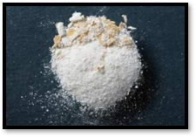
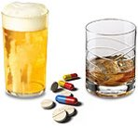
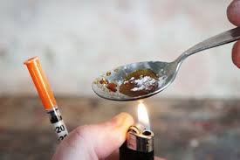

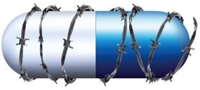
Abuse-Deterrent Formulation with LFHC Technology
C_{max} 
  Patented formulation platforms for IR and modified release profiles as required
  Tailored approaches using specific excipients based on typical routes of abuse. No novel excipients required, only utilizes compendium or GRAS materials for smoother regulatory pathway
  Complete tool kits for in vitro evaluation of abuse deterrence in line with latest FDA guidelines
Increasing “high” and “drug-liking”
drug in plasma
T_{max} 
pre-tampering
post-tampering
time
INSUFFLATION
INJECTION
DOSE DUMPING
MANIPULATION

Slide 23
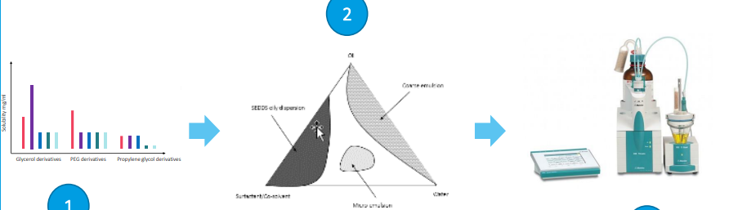

Our systematic & scientific 5 steps approach for LBF Development
Tailored solutions for the many challenges faced through Product Development
Target Product Profile
(TPP)
Pre-formulation , Formulation Development &
in vitro performance / characterization testing
Dosage Form selection & Process development
Dose
Solution / Suspension
Bioavailability enhancement
Immediate / Controlled release
….
Evaluation of API solubility and compatibility with lipid-based excipients, followed by focused formulation design using an internal database of ternary / pseudo ternary diagrams to select the appropriate excipient combinations to increase the API apparent aqueous solubility
Capsule compatibility testing
Capsule shell development (soft capsules)
4
2
API properties
Aqueous solubility
Permeability
Log P
Physical / Chemical stability
Melting point
Salt form / Polymorphism
…
LFHC
Softgels
5
Feasibility trials
Technical batches for stability studies & analytical method development/validation
Scale-up
1
3

Slide 24
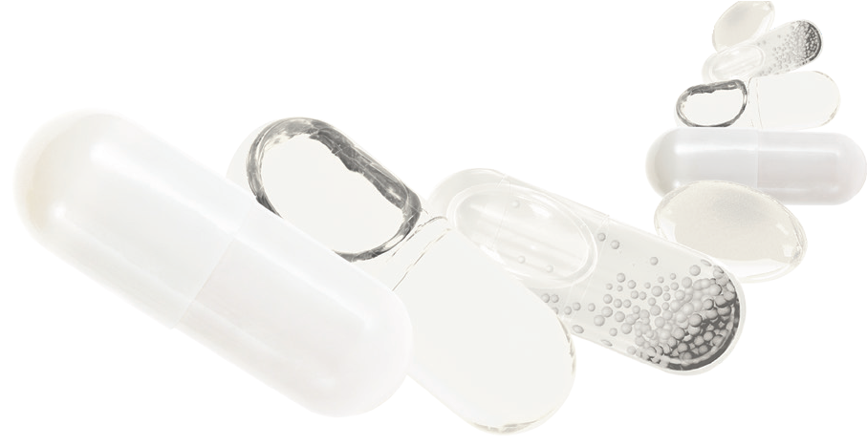
Low Dose Uniformity with LFHC Technology
  Content uniformity for low dose can be challenging solid dosage forms
  Specific excipients selected based on the physiochemical prosperities of the API, to generate solutions or suspensions, suitable for maintaining low dose uniformity
  Precision filling of liquids into capsules using high speed filling machine
  Content uniformity is assured through precision dosing of a stable solution or suspension formulation
 | Batch
Sample No. | 1 | 2 | 3 | 4
% RSD | 0.43% | 0.52% | 0.52% | 0.76%

Slide 25
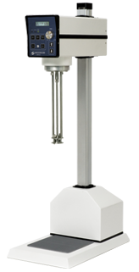
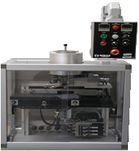
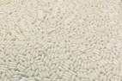
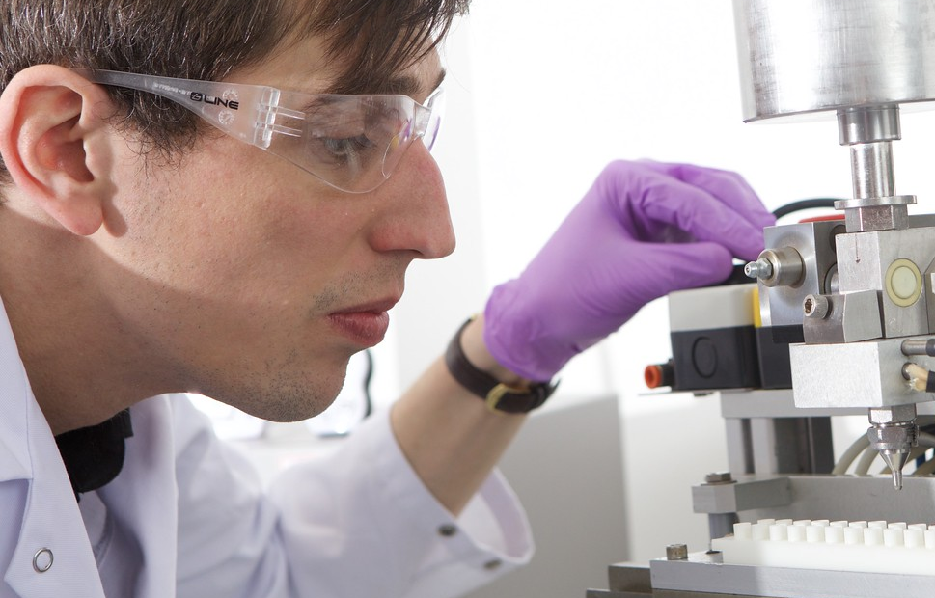
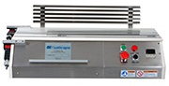
Rapid Scale-Up from Bench to Commercial Equipment
Ease of scale up: Lab to clinical manufacturing to commercial
  Capsule manufacture and technical stability analysis
  Phase-appropriate equipment for developmental and GMP processing
  Transfer is replicated on equivalent or identical equipment
  Formulation experience across hundreds of compounds and target product profiles
  Minimal formulation optimisation required from formulation concepts
  Established QBD, scale-up, tech transfer best practices and protocols
  Optimized filling and sealing processes replicated at each stage of development
Mixing
Filling
Banding

Slide 26
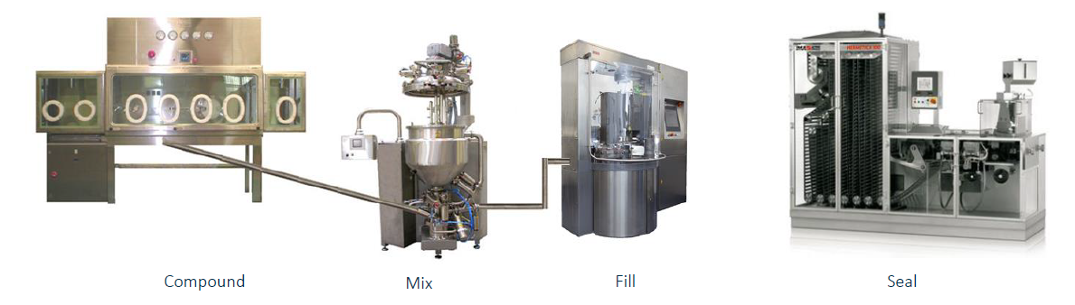
Cleanrooms and Commercial Equipment
One General Cleanroom (3 Commercial Scale Lines)
Mixing vessels up to 500 L size, designed for heating and vacuum
Liquid filling of hard capsules, to temperature of approximately 70°C
Filling of hard capsules at speeds up to 120,000 caps/hour
Banding speeds to match filling machines
Tooling sizes from 4 to 00
Two Equivalent high potency Cleanrooms
Mixing vessels 200L (parallel preparation or 500L options for campaign optimisation)
Negative pressure isolators, designed to also run N₂ inert or dry
Vacuum transfer of powder directly from isolator to high shear mixing head
HP suites all full air extract and secondary, air cascaded, change areas for powder rooms
Currently qualified to 0.05µg/m³
Compound
Mix
Fill
Seal

Slide 27
Our Green Commitment
Path to CO2 Neutrality

Slide 28


CONTACT US
CONTACT
LINKEDIN
ADDRESS
info@nextpharma.com
Unit 1-8 Oakbank Parkway
Livingston
Scotland EH53 0TH
UK
Phone:+441506448080
Fax: +441506448081

